Slide 1
AI-Based Streaming Enhancing System
Damascus University – FITE AI Department - 2022

Slide 2
Contents
Overview (3 min)
Audio Processing System (3 min)
Video Processing System (3 min)
Evaluation (3 min)
Live Demo (8 min)

Slide 3
Overview
Streamer
Our System
Client
Stream
Stream
Country A
Country B
Country C

Slide 4
Overview
Goals:
Video Content Aware Encoding
Audio Noise Reduction
Speech To Text Translation
In Real Time…..
Results:
Better Stream Receiving Experience
Cheaper Stream Receiving

Slide 5
Overview
Broadcasting
Video conferencing
Speech applications
Etc…

Slide 6
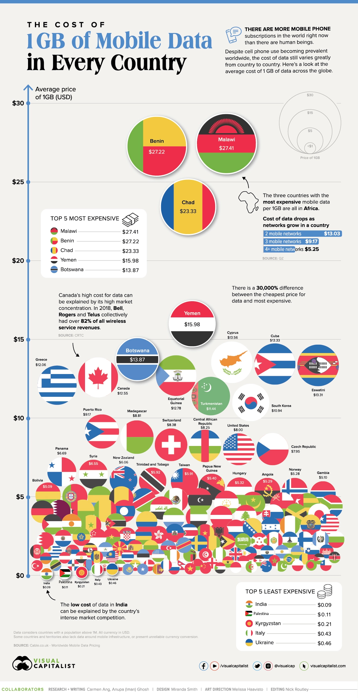
VPS Benefit
Source: link

Slide 7
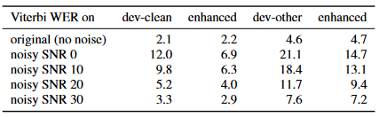
APS Benefit
Improve ASR Performance Under Noisy Conditions
Source: link

Slide 8
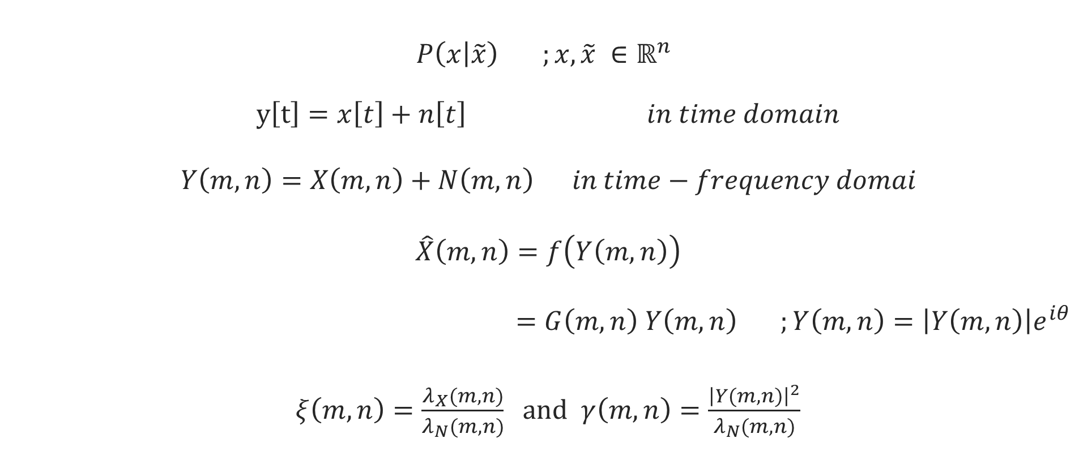
Audio Processing System
$P\left(x | \tilde{x}\right) ;x,\tilde{x} ∈ℝ^{n}$
$y\left[t\right]=x\left[t\right]+n\left[t\right] in time domain$
$Y\left(m,n\right)=X\left(m,n\right)+N\left(m,n\right) in time−frequency domai$
$\hat{X}\left(m,n\right)=f\left(Y\left(m,n\right)\right)$
$=G\left(m,n\right) Y\left(m,n\right)$ $;Y\left(m,n\right)=\left|Y\left(m,n\right)\right|e^{iθ}$
$ξ\left(m,n\right)=\frac{λ_{X}(m,n)}{λ_{N}(m,n)}$ and $γ\left(m,n\right)=\frac{{\left|Y(m,n)\right|}^{2}}{λ_{N}(m,n)}$

Slide 9
Audio Processing System
Thresholding Based Audio Denoiser
PSD Estimation Based Audio Denoiser
Demucs Based Audio Denoiser

Slide 10
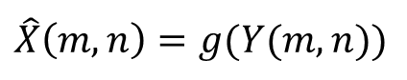
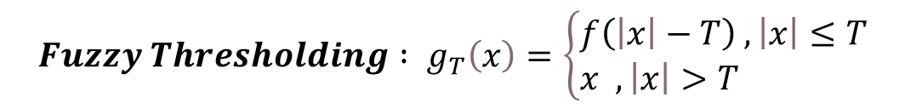
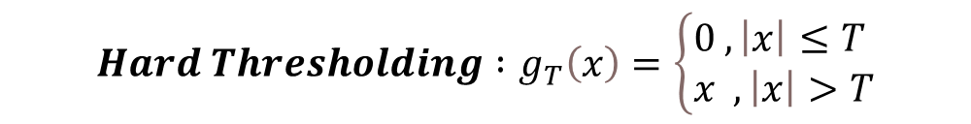
Thresholding Based Audio Denoiser
$$\hat{X}\left(m,n\right)=g(Y(m,n))$$
$$Hard Thresholding :g_{T}\left(x\right)=\left\{\begin{aligned}&0 ,\left|x\right|≤T \\ &x ,\left|x\right|>T\end{aligned}\right.$$
$$Fuzzy Thresholding : g_{T}\left(x\right)=\left\{\begin{aligned}&f\left(\left|x\right|−T\right) ,\left|x\right|≤T \\ &x ,\left|x\right|>T\end{aligned}\right.$$

Slide 11
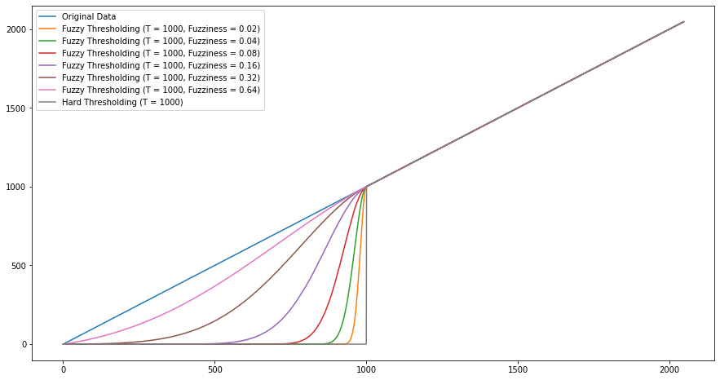
Thresholding Based Audio Denoiser

Slide 12
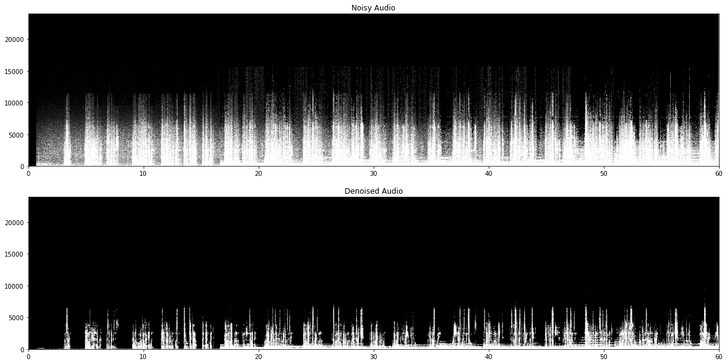
Thresholding Based Audio Denoiser

Slide 13
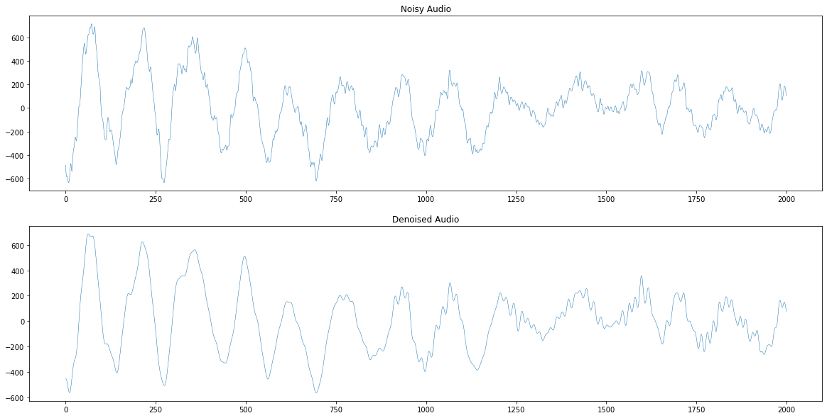
Thresholding Based Audio Denoiser

Slide 14
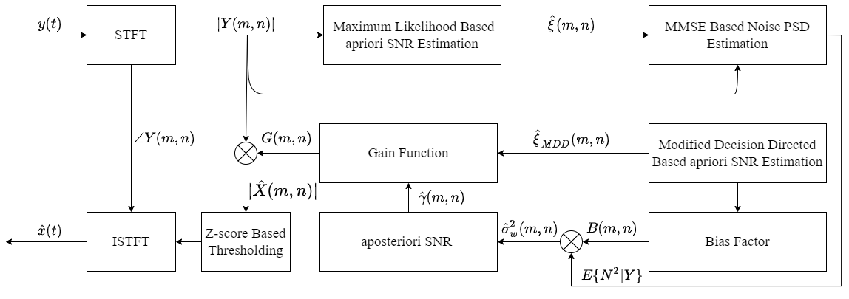
PSD Estimation Based Audio Denoiser

Slide 15
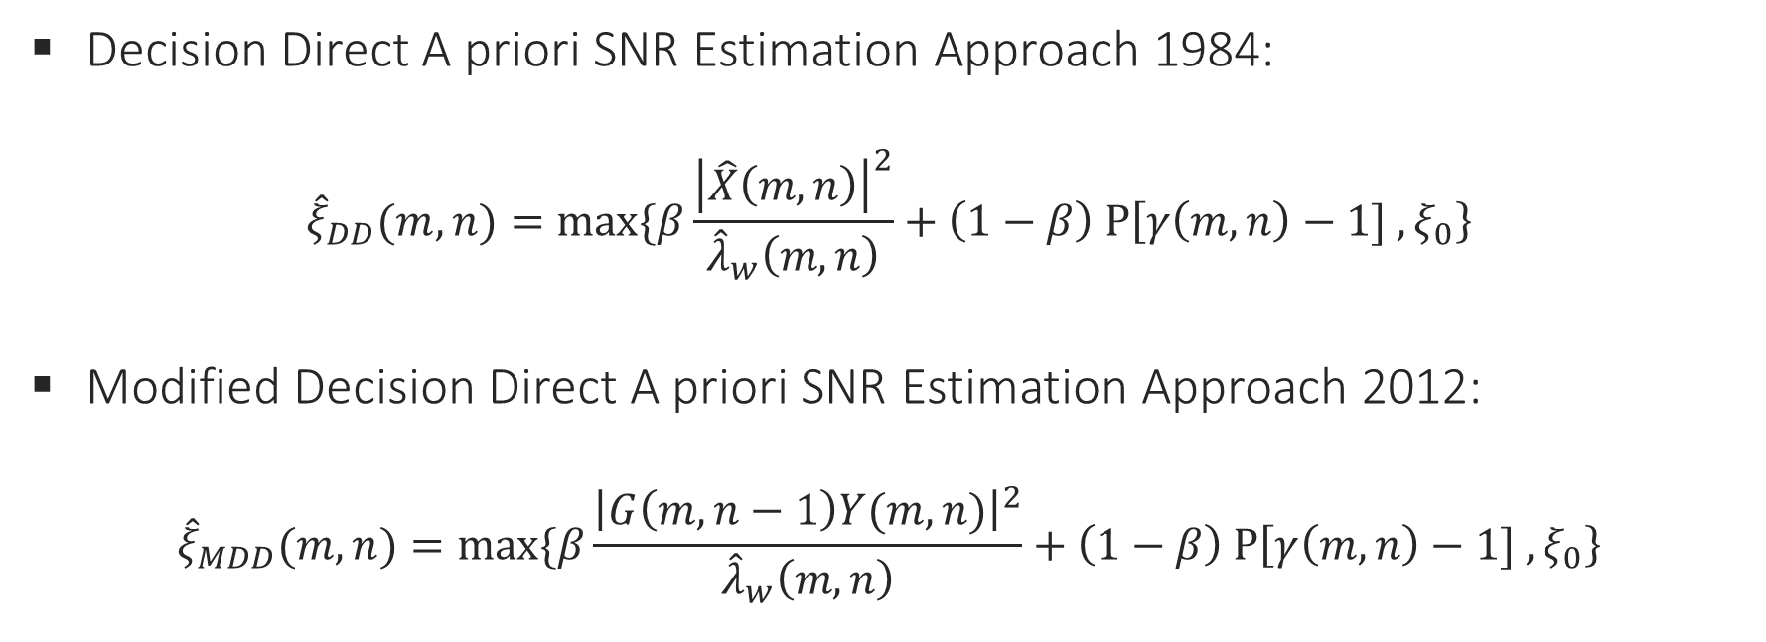
PSD Estimation Based Audio Denoiser
Decision Direct A priori SNR Estimation Approach 1984:
$${\hat{ξ}}_{DD}(m,n)=max⁡\{β\frac{{\left|\hat{X}\left(m,n\right)\right|}^{2}}{{\hat{λ}}_{w}\left(m,n\right)}+\left(1−β\right) P\left[γ\left(m,n\right)−1] ,ξ_{0}\right\}$$
Modified Decision Direct A priori SNR Estimation Approach 2012:
$${\hat{ξ}}_{MDD}(m,n)=max⁡\{β\frac{{\left|G\left(m,n−1\right)Y(m,n)\right|}^{2}}{{\hat{λ}}_{w}\left(m,n\right)}+\left(1−β\right) P\left[γ\left(m,n\right)−1] ,ξ_{0}\right\}$$

Slide 16
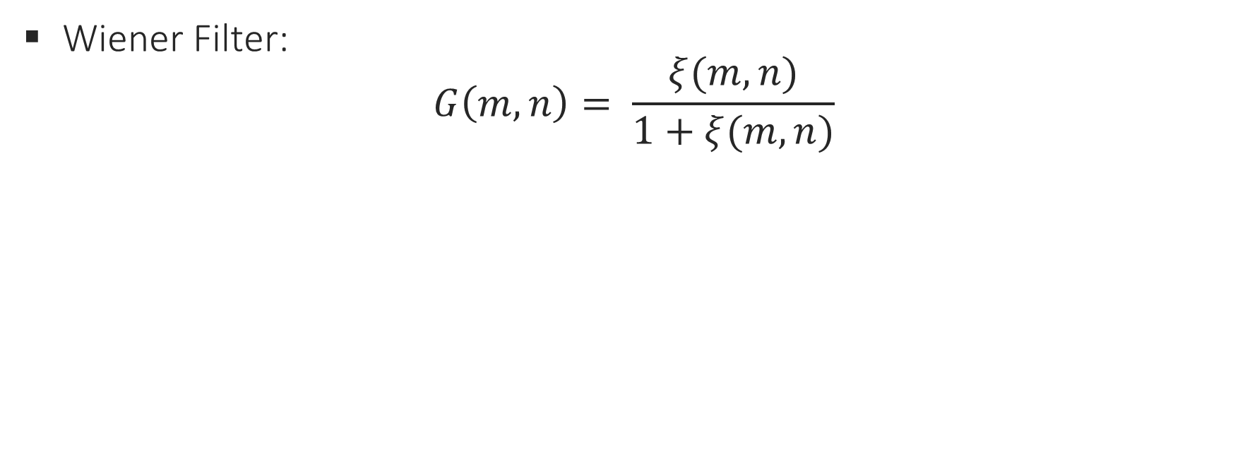
PSD Estimation Based Audio Denoiser
Wiener Filter:
$$G\left(m,n\right)= \frac{ξ(m,n)}{1+ξ(m,n)}$$

Slide 17
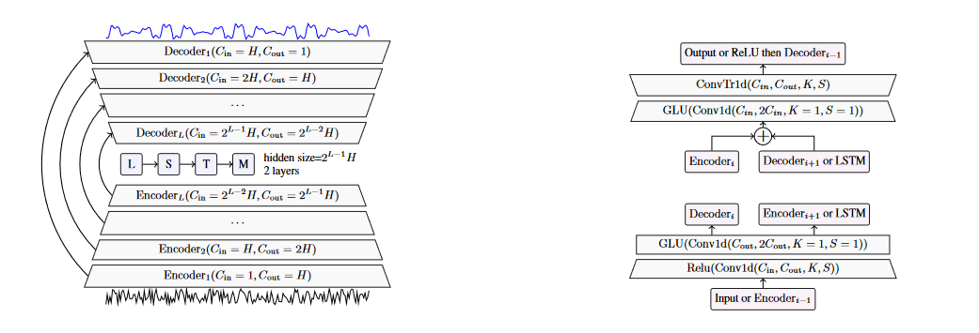
Demucs Based Audio Denoiser

Slide 18
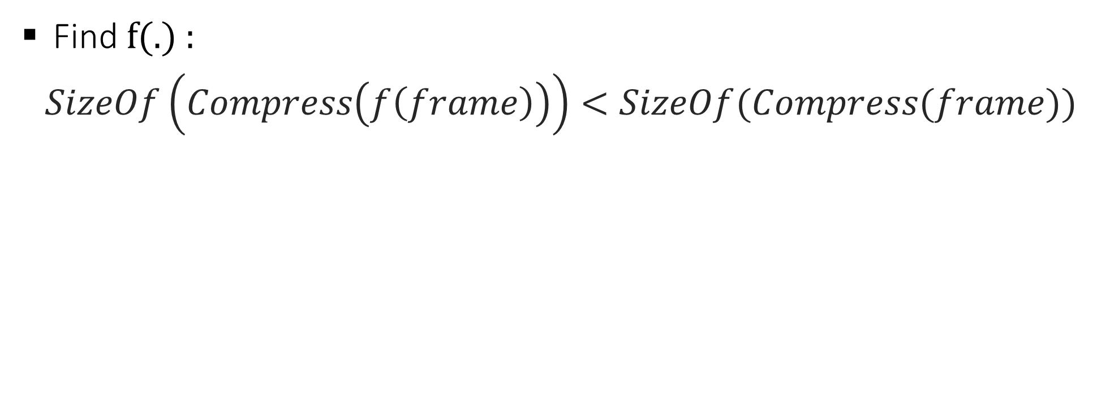
Video Processing System
Find f(.) :
$$SizeOf\left(Compress\left(f\left(frame\right)\right)\right)<SizeOf(Compress(frame))$$

Slide 19
Video Processing System
Selfie Segmentation Based Content Aware Encoding
Background Subtraction Based Content Aware Encoding

Slide 20
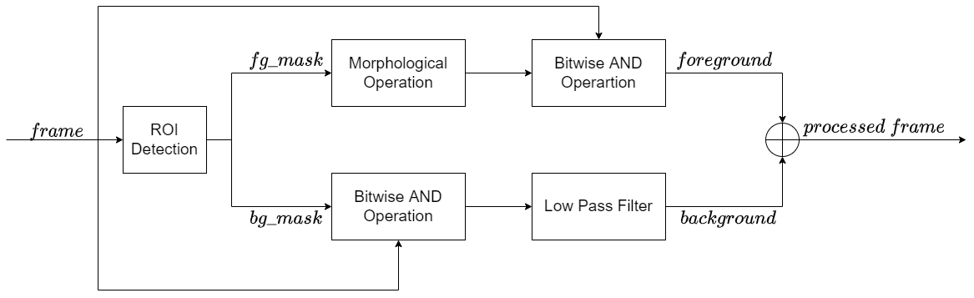
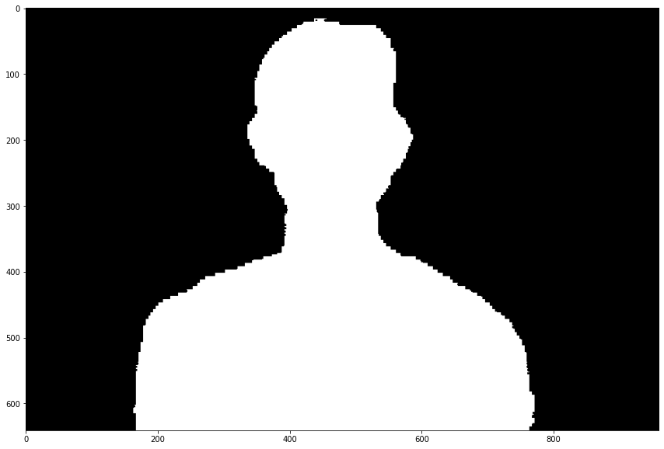
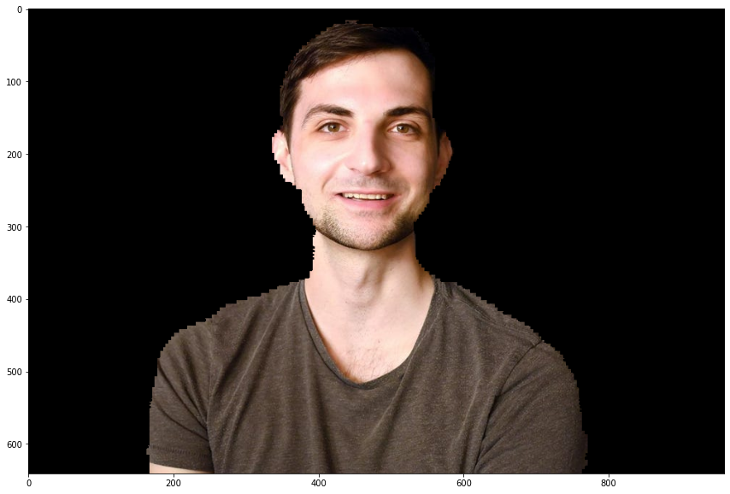
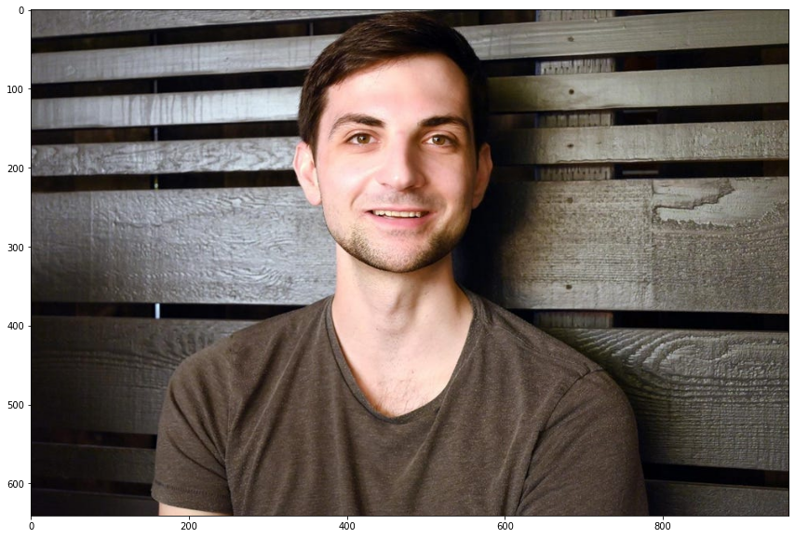
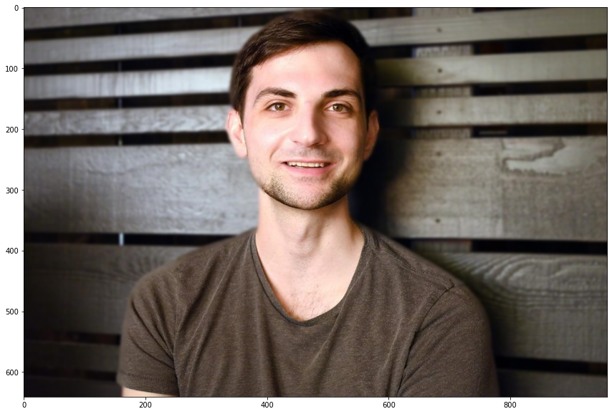
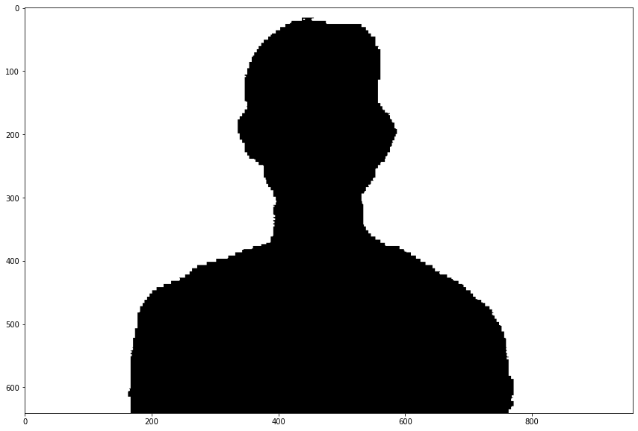
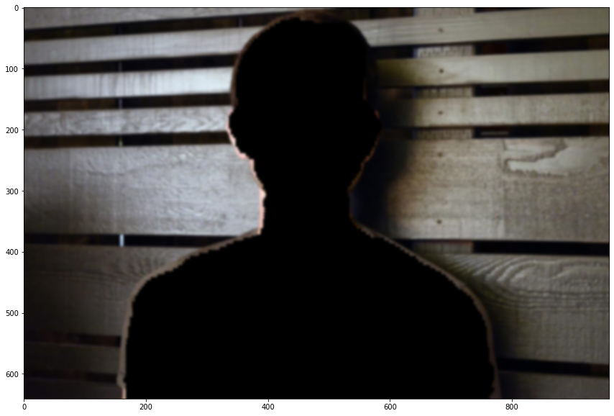
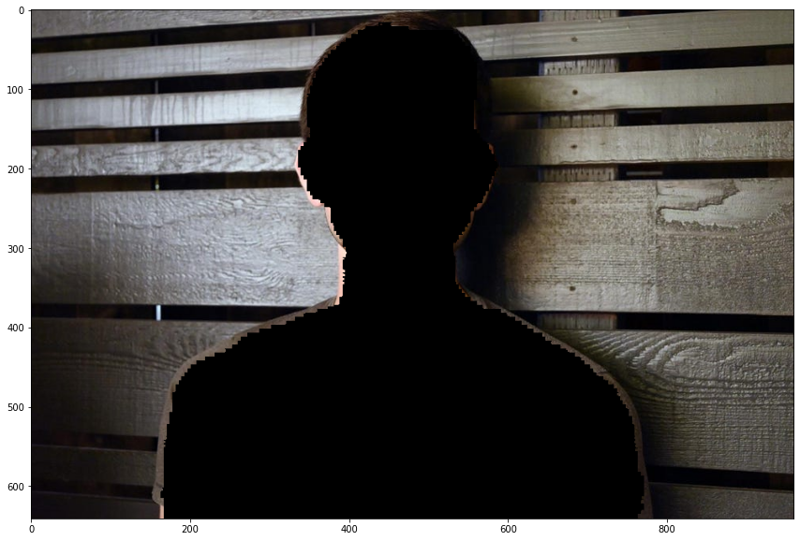
Video Processing System

Slide 21
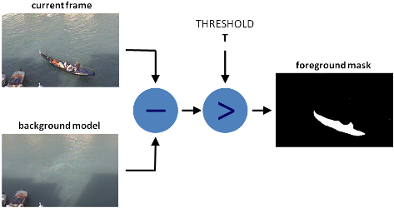
Background Subtraction Based CAE
Using Background Subtraction as ROI Detection Algorithm
CNT ,KNN ,GMG ,MOG ,MOG2…etc

Slide 22

Selfie Segmentation Based CAE
Using MobileNetV3 as ROI Detection Algorithm
General Model ,Landscape Model

Slide 23
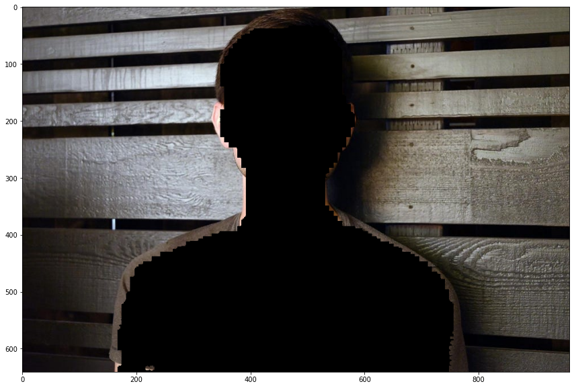
Selfie Segmentation Based CAE
General Model
Landscape Model

Slide 24
APS Eavaluation
Evaluation metrics
SNR
RMSE
PESQ

Slide 25
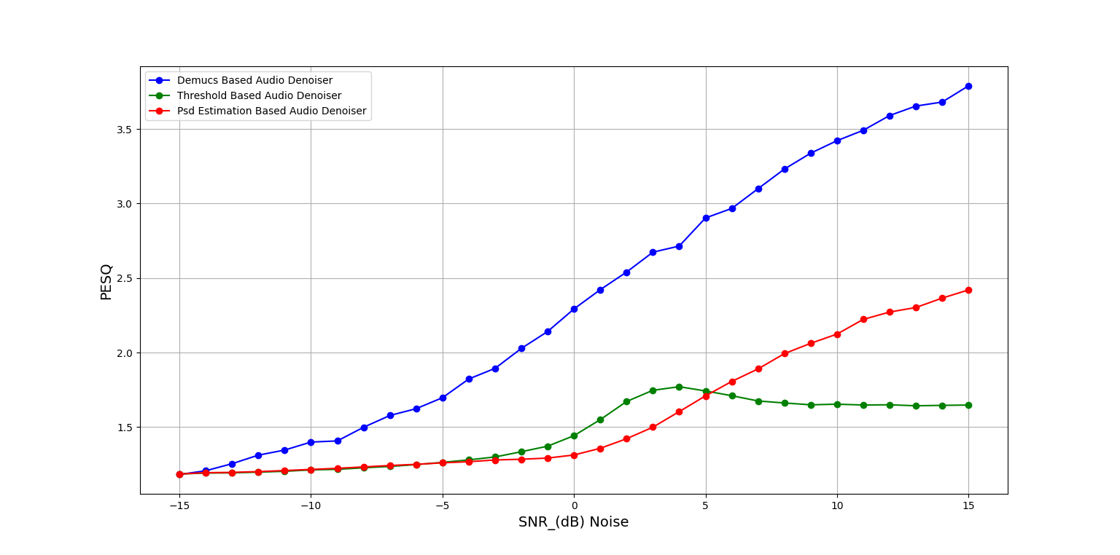
APS Eavaluation

Slide 26
VPS Evaluation
Evaluation metrics
Bitrate
PSNR
SSIM

Slide 27
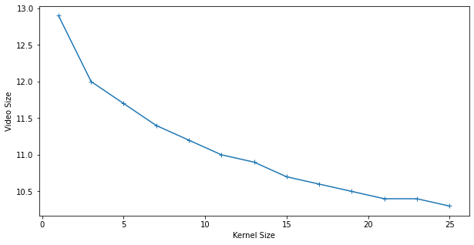
VPS Evaluation

Slide 28
System Architecture
Server
VPS
Video
Streamer
Receiver
Divider
APS
Aggregator
Sender
Client
Stream
Stream
Audio
TPS
Request
Manger
Request

Slide 29
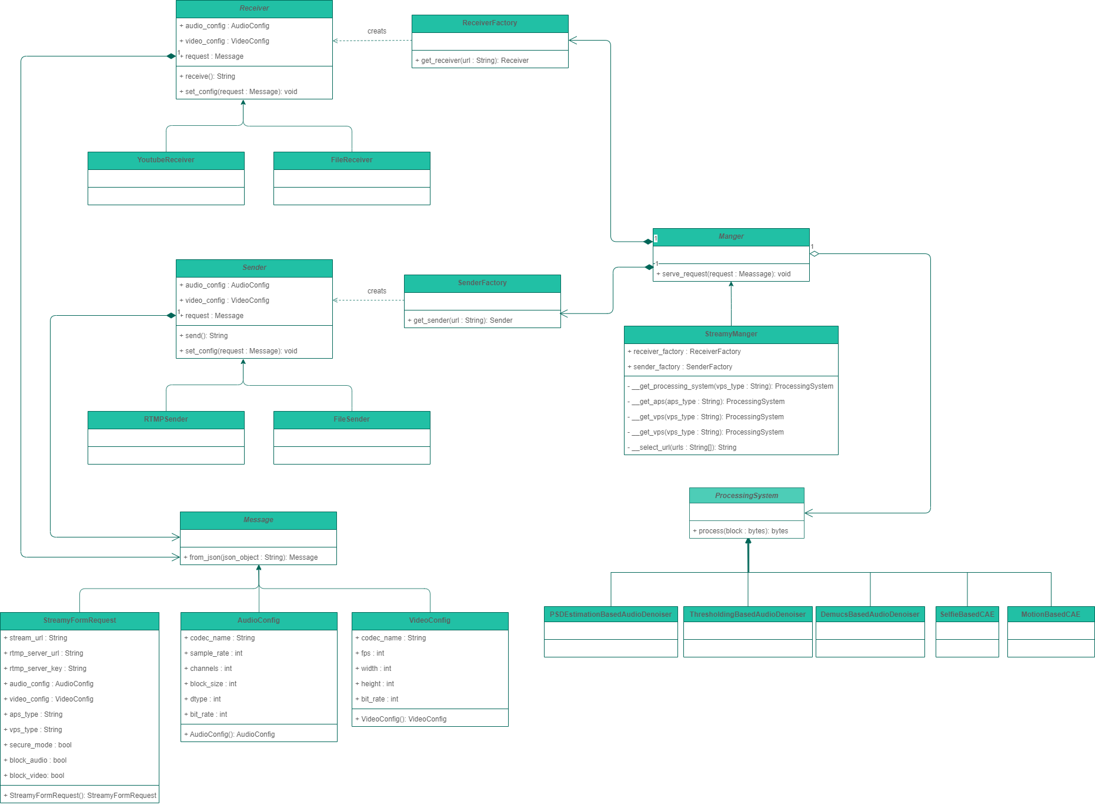
Class Diagram

Slide 30
Class Diagram

Slide 31
Class Diagram

Slide 32
Class Diagram

Slide 33
Class Diagram

Slide 34
Technologies
Python as a programming language
Scipy for Signal Processing
OpenCV for Image Processing
FFmpeg for Stream Coding & Decoding
Subprocess for Processes Management
Numpy for Mathematical Operations

Slide 35
Live Demo!

